Slide 1
Banking Procedures
2024-2025
7/11/2024

Slide 2
Overview
The Food Services Division is responsible for recording all sales transactions and providing documentation of the cash collected.
Each site will accurately account for all cash collected and provide details of each sales transaction.
SCHOOL

Slide 3
Financial Responsibility
Cafeteria funds are public funds. The Food Service Manager (FSM) is accountable for ensuring their operation complies with Federal and State regulations, and District policies regarding:
Collection process
Documents required
Deposit procedures
Safeguarding funds

Slide 4
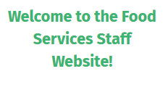
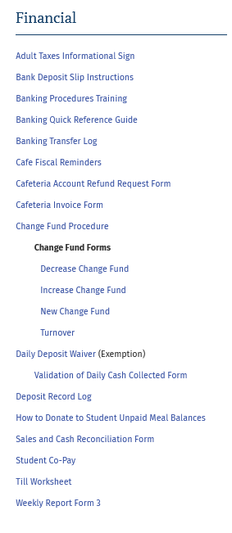
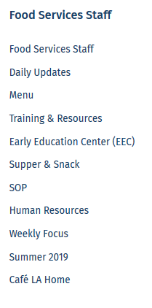
Banking Documents and Resources
All of the Banking forms, discussed in this training, are located on the Café LA website, Training and Resources page, in the Financial section
Notes:
Tell: All of the banking documents and resources can be found on the Food Services Website, under the Training and Resources Section, scroll under the Financial Section.
All the required forms and documents can be found in this section.

Slide 5
Change Fund Forms
Complete and submit the applicable form for your site.
Establishing a Change Fund
Increase Change Fund
Decrease Change Fund
Turnover of Change Fund
Forms can be found on
FS website > Training & Resources > Financial section.
Notes:
TELL: Changes that occur throughout the year: such as employees moving from one location to another, new hires, long or short-term change of assignments. We have a responsibility to make the necessary required updates as they occur. First use the correct form for the process you are updating, additionally check and insure that the form is current. Is the change fund forms current at your location in which you work? If not update ASAP. To establish a change fund use form new, to increase the already established change fund use the increase, to decrease the established change fund decrease, if you leave a location, it is your responsibility to complete the turnover fund form. All forms can be found under the training and resources tab, scroll down to Financial Section and select the desired form. The documents and resources pertaining to banking can all be found in this section. Note: this information should also be accurate on the Cafeteria Information Sheet.

Slide 6
Change Fund Forms - Reasons
Always obtain approval from Café Fiscal before making changes to the change fund. Use the applicable form.
“Increase Change Fund” Do not use collections to add to the change fund. A check will be issued by Café Fiscal in the amount approved
“Decrease Change Fund” Deposit the approved amount and make a note of the amount in the bank deposit memo box
“Turnover of Change Fund” is completed when the physical handoff of the fund from the outgoing manager to the incoming manager takes place
Notes:
TELL: Approval from Café Fiscal must be obtained in order to make any changes to the change fund. Once the approval has been obtained the appropriate action can be performed as needed. Identify the course of action and complete the necessary form. As indicated on the slide.

Slide 7
Till Bag Purpose
The till bag is a safeguarding tool used to secure money for a short-term period. During service time, store the following items in the till bags:
Till money
Cash collection
Till Worksheet Form
Note: Additional till bags can be requested from a Bank of America branch
Notes:
Tell: The till bag is a safeguarding tool used to secure money for a short-term period. During service time, store the following items in the till bags: till monies, any cash collections, and the till worksheet. Remember the number on the till bag supports the till worksheet form. If needed additional till bags can be requested from Bank of America branch.

Slide 8
Till Bag Setup Instructions
Assign a numbered bag to a specific cashier (use permanent marker)
Each cashier is responsible for placing the till money back into the till bag at the end of each serving period
FSM will place the till bags in the safe
1
2

Slide 9
Till Worksheet
The till worksheet form is used to record the amount in each till before and after each serving period.
Till Worksheets are completed daily and used by cashiers at each point of service (POS)
A change fund amount is set for each POS
CEP sites must have at least a $1.00 change fund at each POS register
To verify accuracy run the till report
Reconcile any discrepancies
Notes:
Tell: A Till Worksheet is a form to establish and verify till amounts before and after each serving period.
Till Worksheets are completed daily and used by cashiers at each Point Of Service (POS). A change fund must be established for each POS. CEP sites must have at least a $1.00 change fund at each POS register. To verify accuracy, run the till report. All sales must specify whether its for Students or Adults.

Slide 10
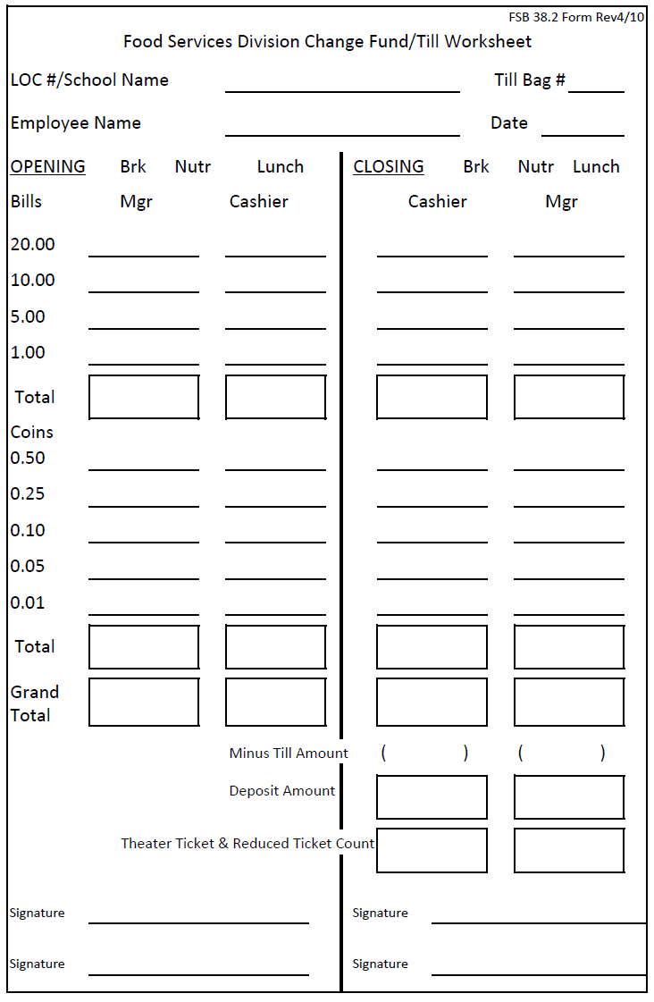
Opening The Till Worksheet
Manager
Count the currency first and then the coin. Record the amount on the Till Worksheet, then sign to verify.
ABC Elementary
1
Cole Winston
8/21/24
1
1
5
$20.00
13
12
10
5
$5.00
$25.00
Ryan Kate
Notes:
TELL: Let's look at the illustration: The FSM will count the currency first and then the coin. She or he will then record the amount on the Till Worksheet then sign verifying the amount placed into the till bag. The process will continue based upon the number of tills utilized at your site.

Slide 11
Opening the Till Worksheet
Cashier
Cashier will count money received and record amount on the Till Worksheet and sign to verify.
ABC Elementary
1
Cole Winston
8/21/24
1
1
1
1
5
5
$20.00
$20.00
13
13
12
12
10
10
5
5
$5.00
$5.00
$25.00
$25.00
Ryan Kate
Cole Winston
Notes:
TELL: The cashier will start first counting the currency and then the coins. The amount of cash received inside the till bag will be recorded on the till worksheet and a signature confirming the total.

Slide 12
After meal service, cashier(s) will count till money. Next, they will record amount in the closing cashier column on Till Worksheet and sign to verify.
ABC Elementary
1
Cole Winston
8/21/24
1
1
2
1
1
4
5
5
7
$20.00
$20.00
$47.00
13
13
23
12
12
15
10
10
19
5
5
15
$5.00
$5.00
$8.35
$25.00
$25.00
$55.35
$25.00
$30.35
Ryan Kate
Cole Winston
Cole Winston
Notes:
Tell: After the meal service the cashier will count the till money starting with the currency , record all denominations and then record currency total, next she will count the coin, record the amount received for each denomination and total. The next step combine the currency total plus the coin total and record the grand total received on the form. The last step cashier will subtract the change fund amount and will record the deposit total and sign

Slide 13
Cashiers will return the till bag and till worksheet to the FSM for review.
Notes:
Tell: The cashiers will bring the till bags at the end of the meal service period to the FSM.

Slide 14
Verify all amounts recorded are accurate by counting and signing the bottom of the Till Worksheet.
ABC Elementary
1
Cole Winston
8/21/24
1
1
2
2
1
1
4
4
5
5
7
7
$20.00
$20.00
$47.00
$47.00
13
13
23
23
12
12
15
15
10
10
19
19
5
5
15
15
$5.00
$5.00
$8.35
$8.35
$25.00
$25.00
$55.35
$55.35
$25.00
$25.00
$30.35
$30.35
Ryan Kate
Cole Winston
Cole Winston
Ryan Kate
Notes:
Tell: Now we will go through the process of closing Under the closing section of the form the cashier has recorded the sum of currency and the sum of coins. The sum of currency and the sum of coins combined provides the grand total. Subtract the till amount from grand total and you have your deposit amount. The Cashier will now sign the form. The FSM will then verify the recorded amounts and record the currency and coin sums, combine the totals, record grand total and subtract the till amount. Indicate the deposit amount and lastly sign endorsing the information is accurate.

Slide 15
Resolving Discrepancies
Discrepancies need to be resolved prior to bank deposit.
Shortages
Overages
Cash counting errors
Refund made on the FSM terminal, but cash was taken from a line terminal
A prepayment entered twice in error
Double meals that were sold in error
Second meals sold in error
Cash counting errors
Voids after deposit was made
Money received was not entered in CMS
Prepayment was received but not applied to account
Change was not returned to customer and not applied to account
Notes:
TELL: First lets take a look at the common causes of cash shortages are when cash was counted incorrectly. It can happen when a refund that is made on the cafeteria manager’s terminal and cash was taken from a line terminal. Also, if a student account payment is entered twice in error. Watch for double meals and second meals sold in error.
Now let’s move onto the common causes of cash overages: cash was counted incorrectly or if a void is made after the bank deposit was completed. Also, when money is received but not entered into the CMS system or a student payment is not applied to the account. Overages can also occur when change is not returned to the customer and also not applied to the customer account. It is the responsibility of each FSM to correctly rectify any shortages or overages and include that in the comment section of the bank deposit memo box.

Slide 16
Daily Revenue
Every day cash is received the FSM is responsible for preparing a deposit slip.
Never combine cash collections for multiple days
Transactions do not allow for personal checks, extended credit, or running tabs
No part of the deposit may be withheld from the bank deposit
Never use deposit funds to buy supplies
Notes:
Tell: For each day that cash is collected the FSM is responsible for preparing a separate deposit slip for that day, regardless of how little the deposit maybe. Remember cash collections can never be combined. Each day cash is collected a deposit slip must be prepared. Food Services Staff may not accept any personal checks, extend credit to anyone , or run a tab for a customer. No part of the deposit can be withheld from the daily cash received. Never use deposit funds to buy cafeteria supplies. All cash collections must be securely safeguarded in the school safe or a locked drawer.

Slide 17
Documentation
All reports relating to the meal service and cash collections are legal documents that support FSD claims for reimbursement. FSM must verify that:
Bank deposit slips are prepared accurately
Forms and documentation are prepared properly to account for and provide an audit trail for the following:
Cash deposits
Invoices issued for catering events
Special functions
Notes:
Tell: All reports pertaining to the meal service and cash collections are legal documents that support reimbursement claims. FSMs must prepare cash deposits and bank deposit slips accurately within time limitations specified by District policies and regulations. Forms and documentation must be prepared properly to account for and provide an audit trail for all cash, deposits, and invoices issued for special functions.

Slide 18
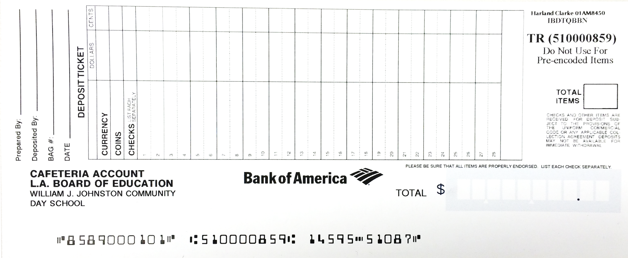
Daily Deposit Information
The deposit slips are pre‐printed with the name of the bank, cafeteria account, and school information.
FSM will manually enter the daily deposit information.
Deposit date
Prepared by
Site ID
Currency amount
Total deposited
Notes:
Tell: The deposit slips are preprinted and include the name of the bank, cafeteria account information and the schools information. When completing the deposit slip include the date month and year. Indicate who it was prepared by, along with the site identification number, record the currency amount and coin amount and then lastly total deposited.

Slide 19
Bank of America Deposit Slips
Deposit slips have a unique 10-digit account number that belongs specifically to the individual site.
Deposit slips are site specific to each cafeteria
Main sites have their own CMS ID and use the deposit slip specific to the site
Off sites have their own CMS ID and use a separate deposit slip different from the parent site
Notes:
Tell: The Bank of America Deposit slips have a unique 10-digit account number that only pertains to your site. Off sites that have their own CMS ID must use a separate deposit slip different from the parent site. Managers should take caution to only use deposit slips specific to the intended site.

Slide 20
Example Deposit Slip
Deposit slip are used to accompany the daily cash deposit for the day. Verify the Account information is correct.
Site location code
Deposit sequence number
Notes:
Tell: Here we have an example of a , deposit slip it is used to record cash collection for the day and is site specific. The site location code is located at the bottom of the deposit slip. Compare this number to the location code of your site to ensure you are completing the correct deposit slip. Reorder deposit slips when the last book is opened by calling Clark America at (877) 202‐8972.

Slide 21
Inputting Bank Deposits in CMS
Café LA Ray
Let us transfer deposit slip information into CMS
Café LA Ray
11/30/2021
5
50
08589
$ 5 . 50
5 5 0
Notes:
Tell: Make sure your deposit amounts are correctly inputted in the Primary Deposit box or the Secondary Deposit box if necessary. Don’t forget to enter the deposit slip number in the Primary Slip # box.

Slide 22
Café LA Ray
Café LA Ray
11/30/2021
Inputting Bank Deposits in CMS
5
50
Verify the date is correct
Enter deposit amount in the “Primary Deposit” section
$ 5 . 50
5 5 0
Enter last 5 digits of the deposit slip in the “Primary Slip #” section
08589
Notes:
Tell: Make sure your deposit amounts are correctly inputted in the Primary Deposit box or the Secondary Deposit box if necessary. Don’t forget to enter the deposit slip number in the Primary Slip # box.

Slide 23
CMS Bank Deposit Memo Box
Make note of any inconsistencies in the memo box, even if the cash variance is $0.01 over or under
08589
Identify if the sale was for student or adult
Surplus of $0.50 due to adult sale, customer forgot their change
Notes:
Tell: Depending on the day’s activities, It is mandatory to make notes of any banking inconsistencies in the bank deposit memo box. Even if the amount is one cent over or short. Always identify if the customer as an adult or student.

Slide 24
Completing CMS Bank Deposits
08589
Once you have verified that all information is correct, click Save and then Close
Surplus of $0.50 due to adult sale, customer forgot their change
Notes:
Tell: When you are finished, click Save and Close. The FS manager or designee will take the deposit to the bank every day (unless the site has an exemption waiver). The FSM manager or designee will receive a copy of the deposit slip which must be filed according to FSD policy.

Slide 25
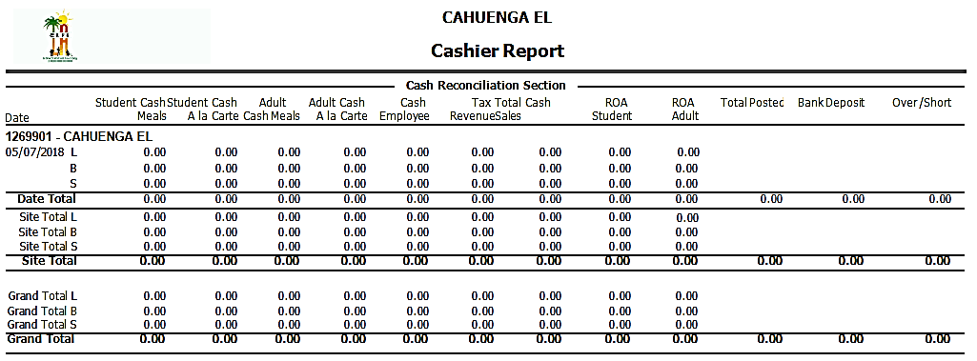
How to Identify Cash Variances
Review the “Cashier Report” to determine any cash amount difference between the total cash deposit and the cash amount shown in the report.
Total Posted Bank Deposit
“Total Posted” should equal “Bank Deposit.” If it does not:
Attempt to resolve the discrepancy first
An explanation is required when discrepancy cannot be resolved
Notes:
TELL: The Cashier Report must be reviewed to determine any cash amount difference between the amount shown in CMS and the amount entered by the FSM. Do not rely on the till report to determine if the cash is in balance. As we review the column headings of the Cashier report please pay particular attention to the Total posted, Bank Deposit, and Over/Short columns. All over/short amounts require an explanation.
CMS communication errors may delay data transmission to the central office server.

Slide 26
Cash Variances Explanation Memo
The FSM will explain all cash variances in the bank memo section of the CMS deposit record. First step is to identify if the variance is due to adult or student sale (the use of “customer” is not specific enough).
Confirm that explanation includes all cash variances
If there is more than one reason for variance, FSM will enter multiple explanations in CMS memo box
FSM will confirm dollar amount explained equals the total amount of the variance that appears in CMS
Notes:
Tell: The FSM will explain all cash variances in the bank memo section of the CMS deposit record. First step is to identify if the variance is due to adult or student sale (the use of “customer” is not specific enough). Confirm that explanation includes all cash variances
If there is more than one reason for variance, FSM will enter multiple explanations in CMS memo box
FSM will confirm dollar amount explained equals the total amount of the variance that appears in CMS

Slide 27
Acceptable Cash Variances Memo
Examples of sufficient memos:
“Surplus of .50¢ due to Adult sale; customer forgot change”
“Adult left $2.00 in change and student left .50¢”
“$100 overage from adult catering invoice #345678, sales tax $9”
“Catering invoice #345679 in the amount of $20 for adult catering service, check #3486 received”
Notes:
TELL: Here are examples of acceptable cash variances memos:
“Faculty left $2.00 in change and student left .50 cents.”
“Overage of $100 from adult catering sale invoice 345678 - sales tax $9”
“Check #3486 received: $20 for adult catering – invoice 345678”

Slide 28
Unacceptable Memos
Examples of Unacceptable Memos
Reason for Unacceptability
Be specific such as student or adult sales related
“Miscounted over by 10 cents”
“3 cents over, customer left extra change”
“Customer” is ambiguous, specify student or adult
“6-8 B-F-0 R-6 L-F-0 R-10”
Unable to understand
“Cashier error”
Not specific enough, specify if the error source is related to student or adult sales
Notes:
Tell: Here are examples of unacceptable memos:
“Miscounted over by .10 cents.” - Be specific indicate student or adult sales
“3 cents over. customer left extra change.” - Customer is ambiguous, specify student or adult
“6-8 B-F-0 R-6 L-F-0 R-10.” - Unable to understand what they are trying to say?
“Cashier error.” - Not specific enough, specify if the error source is student or adult sales related

Slide 29
Depositing
All Main Site Sales
All Offsite Sales
Must be entered into CMS on the main site CMS-ID and must match the deposit slip used for the main site
Must be entered into CMS on the offsite CMS-ID and must match the deposit slip used for the offsite
Use the dropdown box in CMS to select the Offsite deposit record
Do not report under main site
Notes:
Tell: Avoid common errors by confirming that the deposit slip you are using is the correct one. Main Site sales must be entered into CMS on the main site CMS-ID and match the deposit slip for the Main Site. Offsite's also have a CMS-ID and deposit slips for their specific location. That information must also match the deposit slips for the Offsite location.

Slide 30
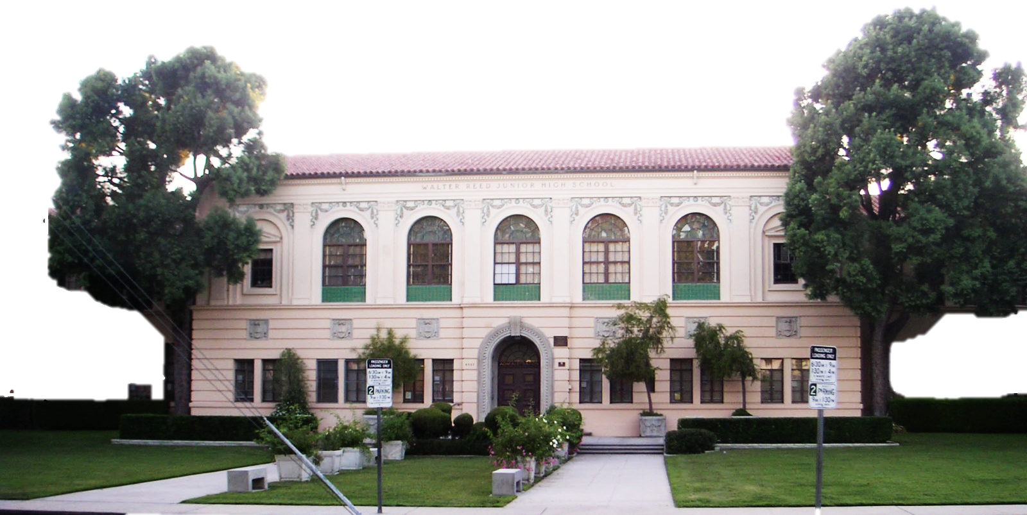
Exemptions to Deposit
Criteria for “Exemption to Deposit Collection Daily” form is used at sites that collect little or no cash daily.
The FSM can apply for exemption
Must provide “Validation of Daily Cash Collected” Form attached to request for AFSS
Approved by the AFSS
Must be submitted and approved annually
The exemption reduces the frequency of bank visits
Notes:
Tell: Some sites collect little or no cash daily. The FSM can apply by completing the Exemption to Deposit Collection Daily Form, attached to the form a validation of the Daily Cash Collected Form. Both must be submitted to the A.F.S.S. for approval. The approval is good for the duration of the year and must be submitted and approved annually. The benefits of the exemption to deposit cash daily is that it reduces the frequency of going to the bank which allows the time to be spent more productively at the site.

Slide 31
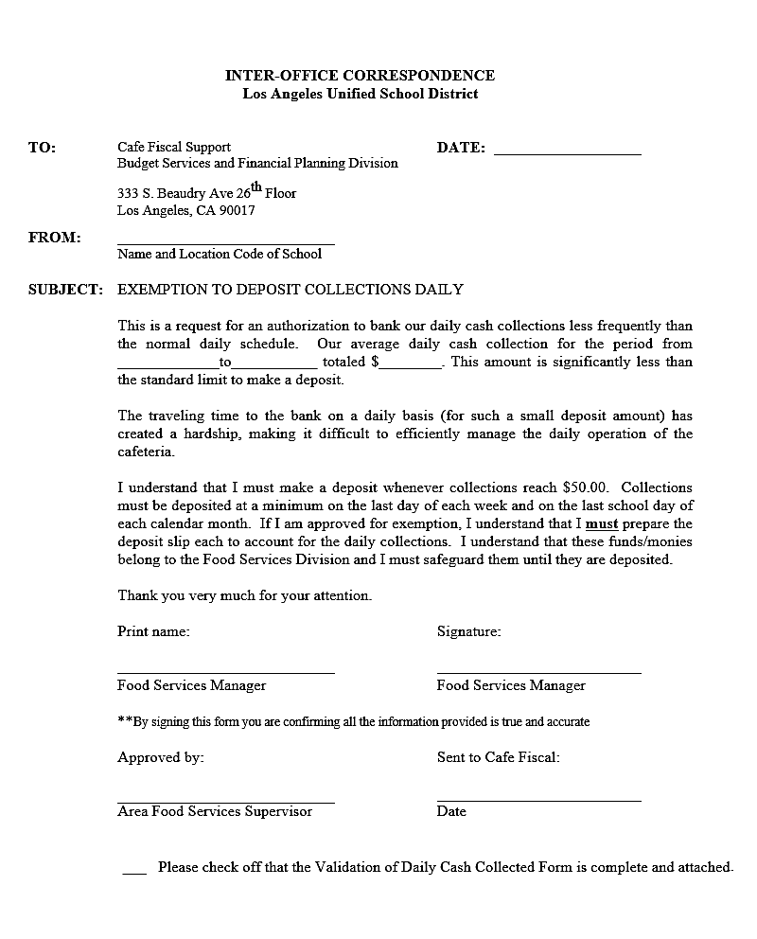
Exemption Timeline Requirements
Deposits must be made:
When cash reaches $50 or more
Every Friday, regardless of amount
The last operating day of the month
Last school day prior to any recess that is longer than a weekend
Ex: Winter, Spring, and Summer breaks
FSM is accountable for following the timeline requirements.
Notes:
Tell: Authorized sites must follow the exemption timeline requirements. These requirements include a deposit slip will be completed for each day cash is collected when cash reaches fifty dollars or more, every Friday regardless of the amount received , the last operating day of the month and the last school day prior to any recess that is longer than a weekend. Each FSM will be held accountable for their deposits being made according to the timeline requirements.

Slide 32
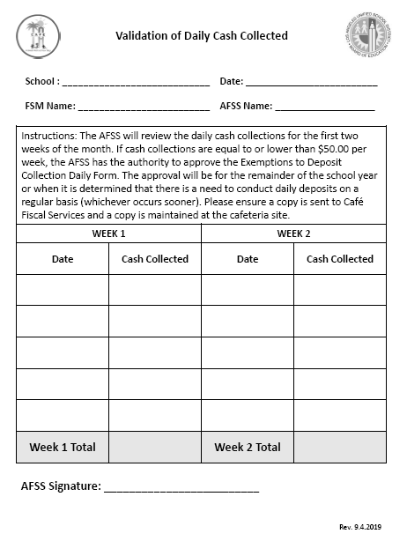
Validation of Daily Cash Collected
AFSS will review the daily cash collections for the first two weeks of the month.
Confirm cash collections are $50 or less
AFSS has the authority to approve the exemption
Notes:
Tell: Authorized sites must follow the exemption timeline requirements. These requirements include: A deposit slip will be completed for each day cash is collected when cash reaches fifty dollars or more, every Friday regardless of the amount received , the last operating day of the month and the last school day prior to any recess that is longer than a weekend. Each FSM will be held accountable for their deposits being made according to the timeline requirements.

Slide 33
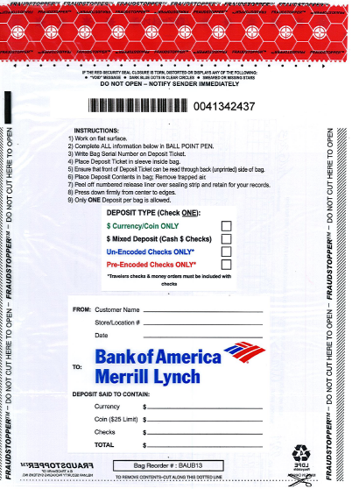
Bank of America Bank Deposit Bag
The deposit bag is prepared and provided with the deposit money for the Financial Manager at a secondary sites only.
Notes:
Tell: The deposit bag is prepared with the deposit money for Financial Manager at a secondary sites only.

Slide 34
Deposit Bag Completion
Numbered release liner
Bank deposit bag number
Choose one deposit type
School name, location code, and date
Contents of bag total (must match deposit slip)
Notes:
Tell: Here is a bank deposit bag. Note some of the features you should be aware of: The numbered release liner which cannot be re-opened, the bank deposit bag number, select the appropriate deposit type, correctly fill out the school information, and correctly total the contents of the bag.

Slide 35
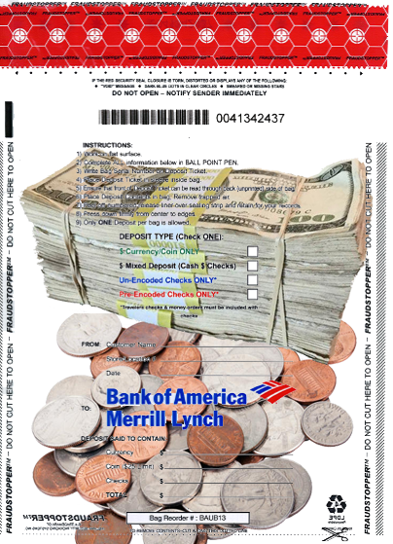
Guidelines for Depositing Coins
Bank of America allows a maximum of $25.00 in coins per deposit bag.
More than $25.00 in coins will require an additional deposit bag and deposit slip
Do not wrap coins
Do not use tape to secure coins
Keep deposit slip visible

Slide 36
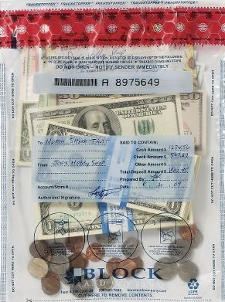
Deposits with Currency and Coins
For deposits with both currency and coin:
Record your currency and coin amount on deposit slip.
If the coins exceed $25.00 an additional deposit bag and deposit slip are needed.

Slide 37
Guidelines for Currency
Properly secure currency:
If a deposit has less than 100 bill per denomination, the bills can be secured with a rubber band for each bundle
When one denomination exceeds 100 bills,
Use currency straps to bundle
Do not fold currency
Notes:
Tell: Bags should not contain loose and/or folded currency. Tell: Do not use tape, staples, excess paper clips, or straps when preparing deposits. This image shows currency that is properly secured. If the currency has less than 100 bills per denomination, then straps are not necessary, and cash can be secured with one rubber band at each end of the bundle.

Slide 38
Banking Surcharges
A surcharge is an additional charge from Bank of America for non-standard deposits such as:
Deposit of non-clear bags
Coins that exceed $25 with currency
Multiple deposits in one bag
Incomplete deposit slips
Loose and/or folded currency
Using tape, staples, excess paper clips or straps
Notes:
Tell: A surcharge is an additional charge that Bank of America issues for non-standard deposits such as: incomplete deposit tickets, deposits of non-clear bags, coin the exceed $25, using tape, staples, excess paper clips or straps, multiple deposits in a single bag, and loose and/or folded currency.

Slide 39
Banking with Financial Managers
At secondary sites, the FSM will give the daily deposit to the Financial Manager. Deposits are picked up by the armored service.
Include a completed deposit slip with the cash deposit
Use the clear plastic bank deposit bag(s)
Complete the Banking Transfer Log
Use the locked bag
Keep the change fund separate from cash deposits
Notes:
Tell: In certain situations, the food services manager will bank through the financial manager. This is common with a secondary site manager. The Food Service Manager will deliver the sealed plastic bank deposit bag(s) and a current Banking Transfer Log within the Locked cloth bag to the Financial Manager.

Slide 40
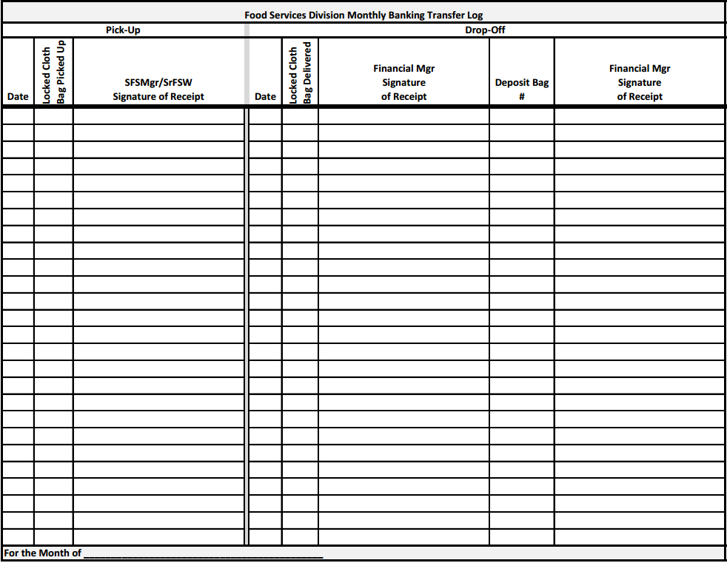
Banking Transfer Log
This form records the transfer of the locked bag and deposit bag(s) from FSM to Financial Manager
Begin a new log for each month
Notes:
Tell: The banking transfer log is the form that helps to record the transfer of the locked bag and deposit bag(s) from FSM to the Financial Manager. Make sure you get the FM signature with the deposit bag number. Remember to begin a new log each month. The FSM should also receive written acknowledgement of the deposit from Bank of America. If FSM does not receive this in the mail, check with the Financial Manager to see if they have it.

Slide 41
Locked Bag
A locked bag is a safeguarding tool used to store cash deposits and change funds during operating hours.
Contact your AFSS for additional locked bags.
Notes:
Tell: A locked bag is a safeguarding tool used to store cash deposits and change funds during operating hours.
Note: Contact AFSS for additional locked bags.

Slide 42
Route of Locked Bag
To secure the money, FSM must place all till bags and prepared deposit bag(s) inside the locked bag.
Elementary School FSM
With safe: lock the bag and place it in the safe until ready to take the money to the bank
Without safe: lock the bag and place inside a locked drawer until ready to take the money to the bank
Secondary School FSM
Lock the bag and place it in the safe until ready to take the money to the Financial Manager
Notes:
Tell: The locked bag is very important to the operation because it is a way to secure the money. The FSM must place all till bags and prepared deposit bag(s) inside the locked bag. For Elementary School’s with a safe, the FSM will lock the bag and place it in the safe until it is time to take the money to the bank. Elementary school sites without a safe should place the bag in a locked drawer, until it is time to take the money to the bank. Secondary school FSM’s should lock the bag and place it in the safe until ready to take the money to the Financial Manager’s office.

Slide 43
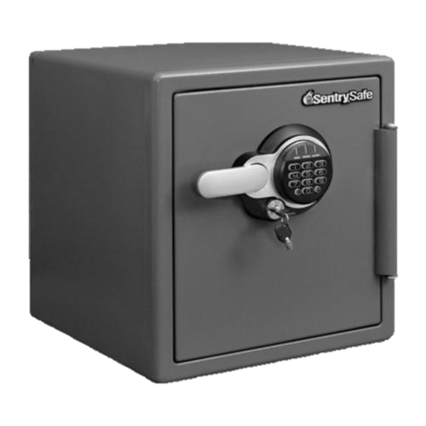
Purpose of the Safe
The safe is used to secure district property during operating hours and should include:
Change fund
Cash deposit
Till bags
Deposit bags
Locked bags
Notes:
Tell: The safe is used to secure district property during operating hours and should include: change fund, cash deposits, till bags, deposit bags, and locked bags.

Slide 44
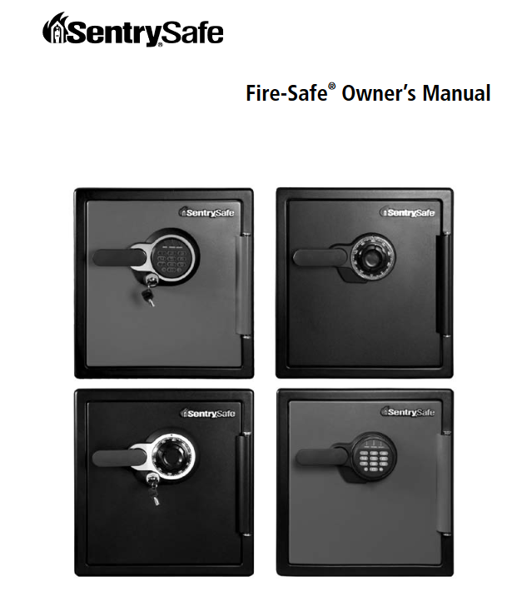
Additional Safe Instructions
The safe instruction manual and key/combination should be filed in the Miscellaneous Folder #11 of the filing system.
FILE #11
Safe Instruction Manual and Key
Notes:
Tell: The cafeteria safe instruction manual and key/combination should be filed in the banking folder #11 of the filing system identified as the Bank Deposit Slip File.

Slide 45
Pricing School Quantity Sales
Quantity sales can affect your bank deposit at pricing schools. Students not listed in CMS are entered as a quantity sale according to eligibility.
A cash shortage will result when a full or reduced-price student that is entered as a quantity sale in CMS does not have their copay for their meal
A memo is necessary in the “Bank Deposit Memo Box”
SCHOOL
Notes:
Tell: Let’s look at meal counts and how they affect your bank deposits.
When quantity sales entries are required at Pricing schools, make sure to enter meals by eligibility: Free, Reduced or Full Price. Full price and reduced-price students should have paid a copay, and the student would have paid cash for it, or used prepaid account, or charged to account. If they have not paid the cash payment, this will appear as a cash shortage in your Bank Deposit Report. Again, an explanation must be noted on the bank deposit memo box….

Slide 46
Potential Cash Collection Spikes
Student debt payments may cause cash collection spikes when:
Parents/guardians are paying into student accounts as the school year starts
Recommend parents/guardians take advantage of the convenience of “My Payments Plus”
Balance Due letters are distributed to households
Secondary sites students receive a checklist that must be completed prior to graduation
Notes:
Tell: Student debt payments may cause a revenue spikes. The graduating checklist requires the student’s debt to be paid and must be checked off prior to graduation. Some sites can receive thousands of dollars in additional revenue due to this check list.

Slide 47
Securing the Change Fund
It is the responsibility of the FSM to properly secure the change fund when school is not in session.
Place in safe or locked drawer
Secure in bank bag
Notes:
Tell: FSM must properly safeguard the cafeteria change fund when school is not in session. The FSM should total and confirm the change fund is the correct amount. Secure the cash in the locked bank bag. Place the bag in a locked safe or drawer. Do not deposit your change fund. In addition complete the end of the year requirements pertaining to banking.

Slide 48
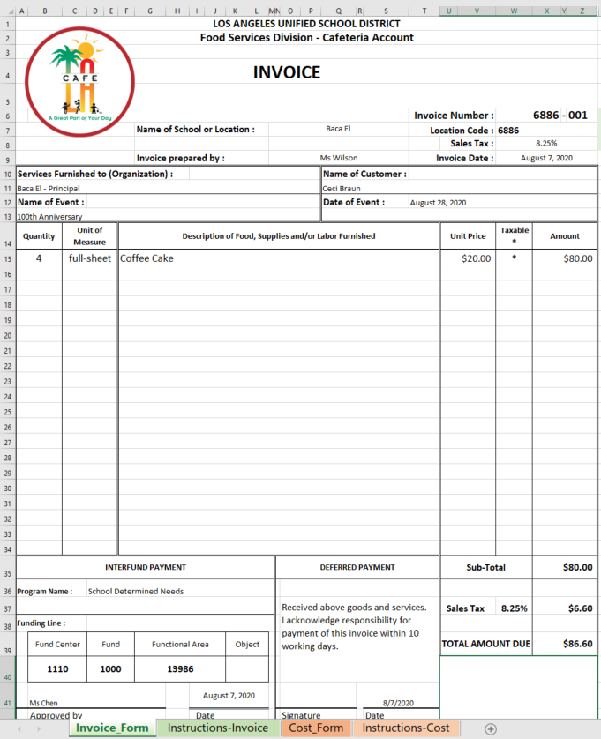
Special Function Invoice
Use the Excel template Special Cafeteria Invoice to document catering, special orders and other billings
FSM will number the form using the four-digit site ID, followed by a three-digit number beginning with 001.
Each new invoice will be numbered sequentially (001,002,003, etc.)
Notes:
Tell:

Slide 49
Special Function Invoice
When completing the form; keep in mind that sales tax is for adult sales only. Use the correct sales tax for your location
LAUSD Tax Rate as of July 2020 (subject to change)
City | Tax Rate
Cudahy | 10.250%
Gardena | 10.250%
Huntington Park | 10.250%
San Fernando | 10.000%
South Gate | 10.250%
All other areas | 9.500%
Notes:
Tell:

Slide 50
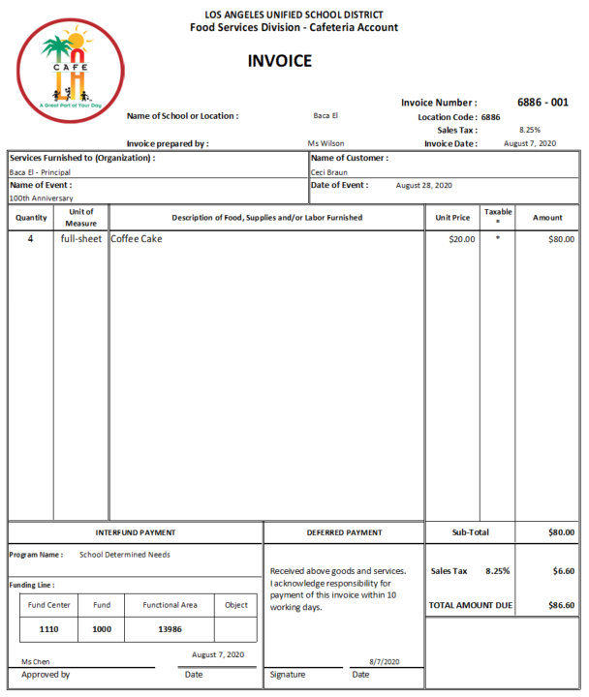
Special Function Payment
For invoices paid in cash or check, write on the invoice “Paid Cash” or “Paid Check.” Include the check number and date received
PAID
Check # 3387
8-8-20
Notes:
Tell:

Slide 51
Interfund Payments
For Interfund payments, the complete funding line must be written on the invoice
Customer must sign the invoice
C. Braun
Notes:
Tell:

Slide 52
Special Function Invoice Collections
Include collections from the Special Function Invoice within the daily deposit. In the CMS bank deposit memo box enter:
Invoice number
Invoice amount
Check number (if check received for payment)
Funding line number (when applicable)
Notes:
Tell: For Special Function Invoices the school site should enter in the bank deposit memo box the invoice number, amount, check number (if a check was received) and specify if sale is for student or adult. Send the yellow copy to Café Fiscal Support. Do not bill more than one month on one invoice.

Slide 53
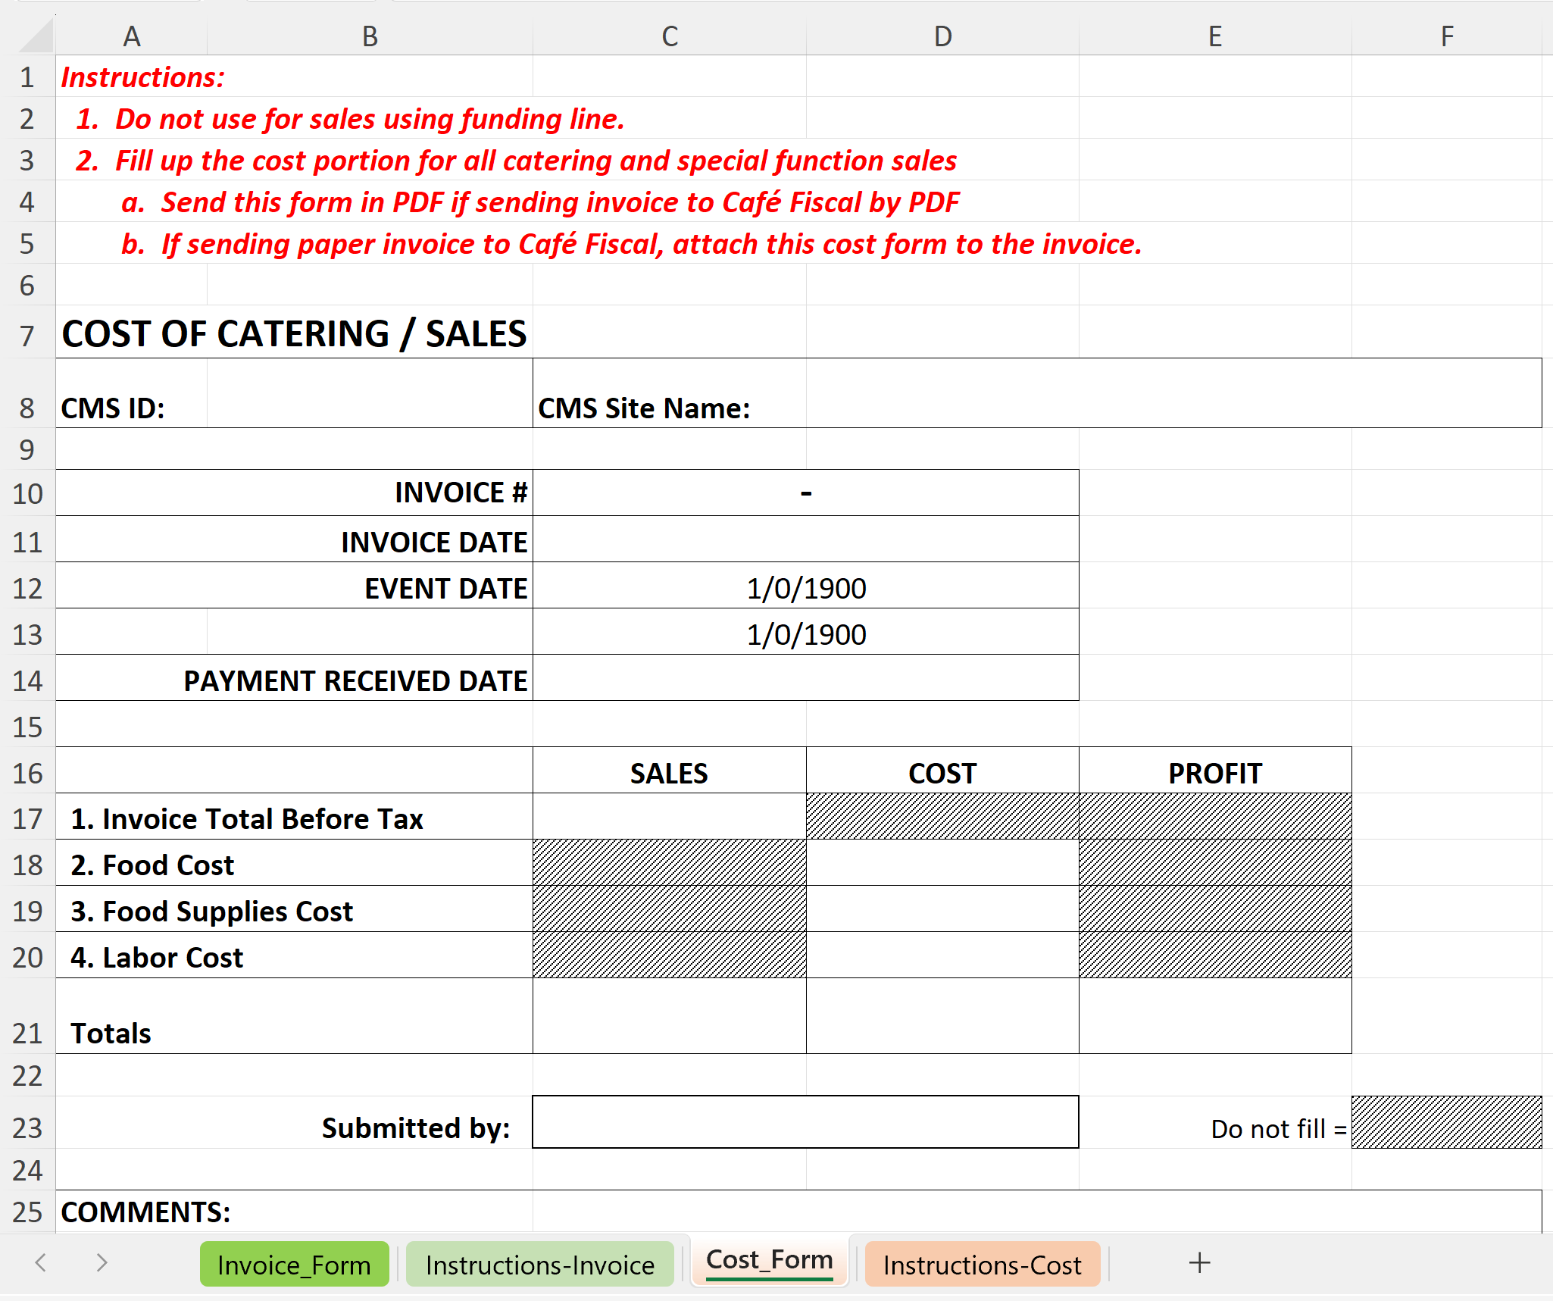
Special Function Invoice Cost Form
Click on the “Cost Form” tab at the bottom of the page to view and complete
Send a clear, readable, copy of the invoice and cost form to Café Fiscal Support, 26th Floor, Beaudry, via school mail. Or send an email with the invoice and cost form to sandra.joya@lausd.net at Café Fiscal support
Notes:
Tell:

Slide 54
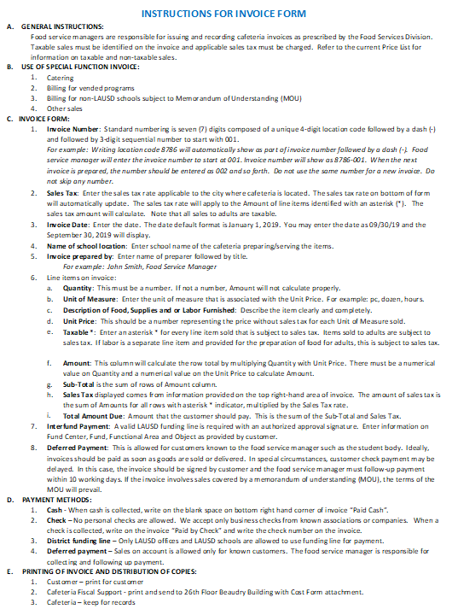
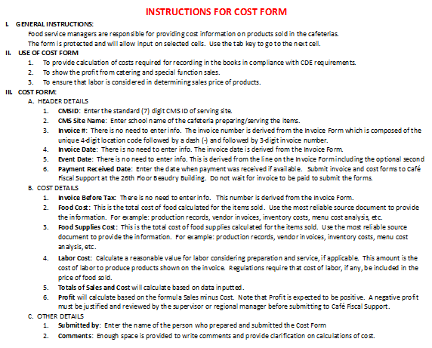
Special Function Invoice Instructions
Follow the instructions on the Cafeteria Invoice Excel template, for details on how to complete the invoice and cost forms
Click on the “Instructions – Invoice” tab at the bottom of the page to view the instructions for completing the invoice
Click on the “Instructions – Cost” tab at the bottom of the page to view the instructions for completing the cost page
Notes:
Tell:

Slide 55
Thank You!
Notes:
Tell:

